Slide 1



Do Now
Write an expression to find the area,
then determine the area of the rectangle using any method.
Students will describe the effects of each parameter in the function rule $y=ax^{2}+bx+c$.
Students will use tables of values and graphs to estimate answers for questions about situations modeled by quadratic functions.
5
x
2
Area $=hb=2(5+x)$
A. | B.
C. | D.
3
x
6
x
3
$\frac{1}{3}$
x
3
Students will sort quadratic functions into categories created by the shape the function creates.
2x
2
x
2x

Slide 2

October 31
Students will describe the effects of each parameter in the function rule $y=ax^{2}+bx+c$.
Students will use tables of values and graphs to estimate answers for questions about situations modeled by quadratic functions.
Happy Halloween!!!
House Keeping Items
Unit 7 Test
Friday, Nov 15
May use Math Tool Kit
Students will sort quadratic functions into categories created by the shape the function creates.

Slide 3
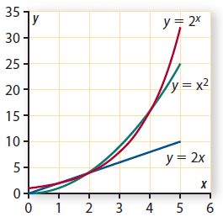
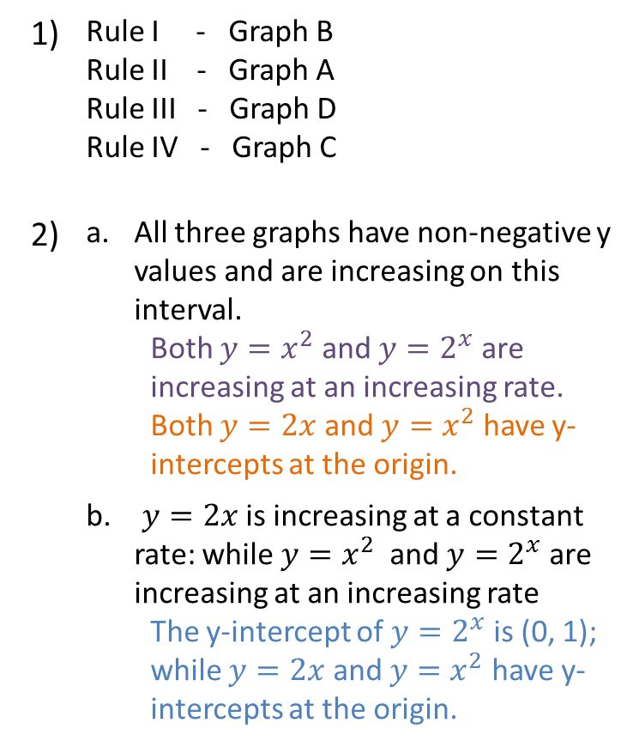
Homework Check
Students will describe the effects of each parameter in the function rule $y=ax^{2}+bx+c$.
Students will use tables of values and graphs to estimate answers for questions about situations modeled by quadratic functions.
U7L1I3 HW – Due October 30
1) | Rule I - Graph B Rule II - Graph A Rule III - Graph D Rule IV - Graph C
2) | All three graphs have non-negative y values and are increasing on this interval. Both $y=x^{2}$ and $y=2^{x}$ are increasing at an increasing rate. Both $y=2x$ and $y=x^{2}$ have y-intercepts at the origin.
 | $y=2x$ is increasing at a constant rate: while $y=x^{2}$ and $y=2^{x}$ are increasing at an increasing rate The y-intercept of $y=2^{x}$ is (0, 1); while $y=2x$ and $y=x^{2}$ have y-intercepts at the origin.
Students will sort quadratic functions into categories created by the shape the function creates.

Slide 4
Math Tool kit
Students will describe the effects of each parameter in the function rule $y=ax^{2}+bx+c$.
Students will use tables of values and graphs to estimate answers for questions about situations modeled by quadratic functions.
Quadratic Functions
Students will sort quadratic functions into categories created by the shape the function creates.

Slide 5
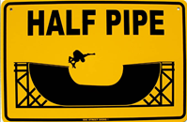
Practice
Students will describe the effects of each parameter in the function rule $y=ax^{2}+bx+c$.
Students will use tables of values and graphs to estimate answers for questions about situations modeled by quadratic functions.
Create an example of a quadratic function that is shaped like a half pipe.
Create an example of a quadratic function that is shaped like an umbrella.
Students will sort quadratic functions into categories created by the shape the function creates.

Slide 6
Math Tool kit
Students will describe the effects of each parameter in the function rule $y=ax^{2}+bx+c$.
Students will use tables of values and graphs to estimate answers for questions about situations modeled by quadratic functions.
Quadratic Functions
Students will sort quadratic functions into categories created by the shape the function creates.

Slide 7
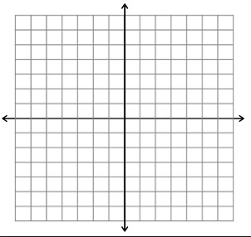








Practice
Students will describe the effects of each parameter in the function rule $y=ax^{2}+bx+c$.
Students will use tables of values and graphs to estimate answers for questions about situations modeled by quadratic functions.
$$y=x^{2}$$
$$y=x^{2}+3$$
$$y=x^{2}−4$$
$$y={−x}^{2}+5$$
$$y=−x^{2}−1$$
$$y={2x}^{2}+1$$
$$y={−x}^{2}$$
$$y={2x}^{2}−3$$
Write each quadratic in the correct category below:
y-intercept is above the x-axis:
y-intercept is on the x-axis:
y-intercept is below the x-axis:
Students will sort quadratic functions into categories created by the shape the function creates.

Slide 8
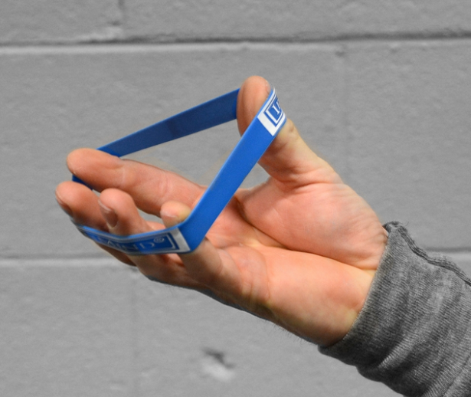
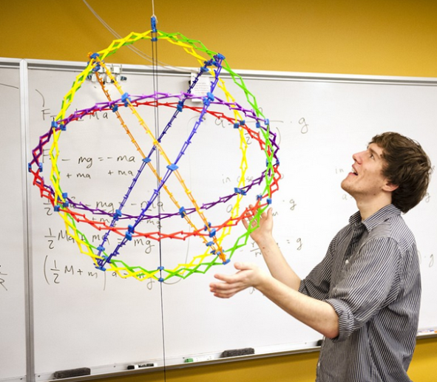
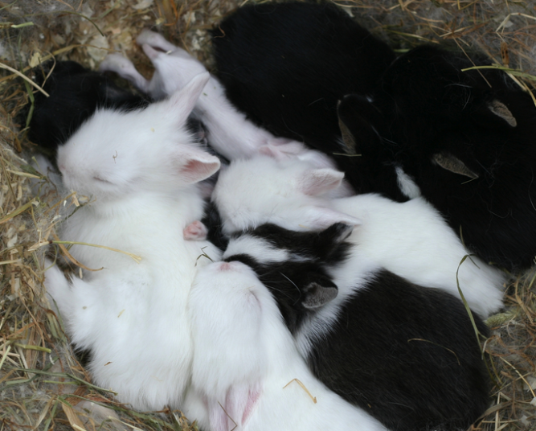

D N Q
G S P
A H O
T X E
$$2\left(5+x\right)$$
$$2∙5+2∙x$$
$$10+2x$$
E X P A N D

Slide 9
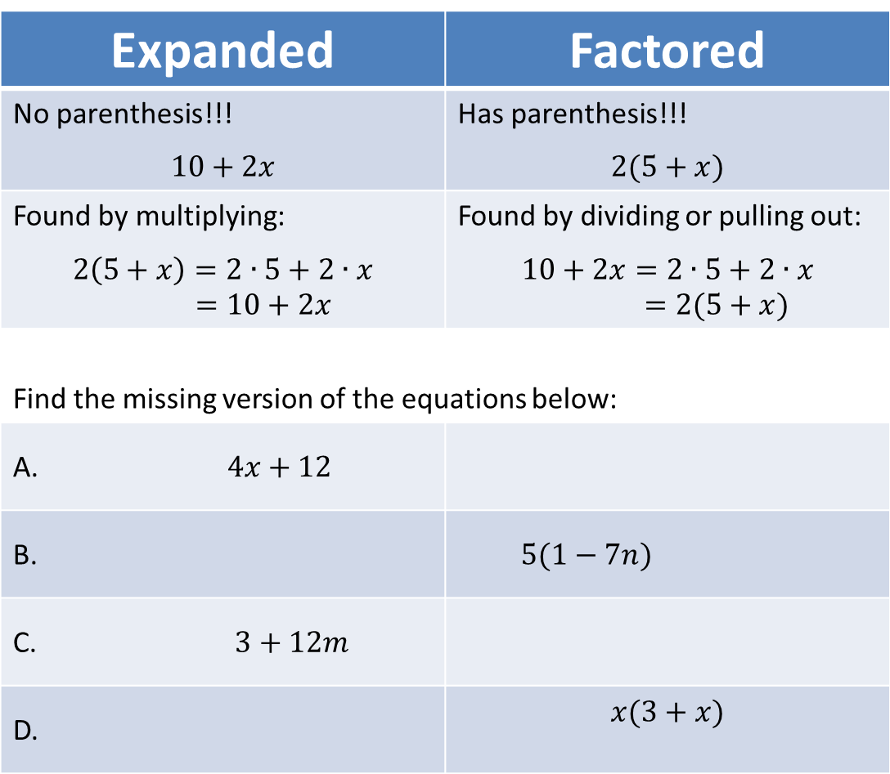
Expanded vs Factored
Students will describe the effects of each parameter in the function rule $y=ax^{2}+bx+c$.
Students will use tables of values and graphs to estimate answers for questions about situations modeled by quadratic functions.
Expanded | Factored
No parenthesis!!! $$10+2x$$ | Has parenthesis!!! $$2(5+x)$$
Found by multiplying: $$2\left(5+x\right)=2∙5+2∙x=10+2x$$ | Found by dividing or pulling out: $$10+2x=2∙5+2∙x=2(5+x)$$
Find the missing version of the equations below:
$4x+12$
B. | $5(1−7n)$
C. $3+12m$
D. | $$x(3+x)$$
Students will sort quadratic functions into categories created by the shape the function creates.

Slide 10
Factored and Expanded forms of Quadratics
Students will describe the effects of each parameter in the function rule $y=ax^{2}+bx+c$.
Students will use tables of values and graphs to estimate answers for questions about situations modeled by quadratic functions.
P475
Working in your groups, read where it states:
Factored and Expanded Forms
Complete all parts of Q5 and Q6
Students will sort quadratic functions into categories created by the shape the function creates.

Slide 11

Exit Ticket
Students will describe the effects of each parameter in the function rule $y=ax^{2}+bx+c$.
Students will use tables of values and graphs to estimate answers for questions about situations modeled by quadratic functions.
Rewrite the following quadratics in expanded form:
    $x(3x−5)$
    $2x(5+x)$
    $\left(6+3x\right)5x$
    $\frac{1}{2}(6x+4x^{2})$
Students will sort quadratic functions into categories created by the shape the function creates.

